Slide 1


Introduction to Cassandra
Dr. Robin Singh Bhadoria,
Associate Professor, Dept. of CEA

Slide 2
Outline
Apache Cassandra – An Introduction
Features of Cassandra
Peer-to-Peer Network
Writes in Cassandra
Hinted Handoffs
Tunable Consistency: Read Consistency and Write Consistency
CQL Data Types
CQLSH
CRUD : Insert, Update, Delete and Select
Collections : Set, List and Map
Time To Live (TTL)
Import and Export

Slide 3
Cassandra
It is free and open-source, distributed, wide-column store, NoSQL database management system.
It is designed to handle large amounts of data across many commodity servers, providing high availability with no single point of failure.
It offers support for clusters spanning multiple datacenters with asynchronous masterless replication allowing low latency operations for all clients.

Slide 4


Creators of Cassandra
It initially developed Cassandra at Facebook to power the Facebook inbox search feature in July, 2008.
Avinash Lakshman
Prashant Malik

Slide 5
Apache Cassandra – History
The word “cassandra” has been derived from Greek mythology – in which it was a Trojan priestess of Apollo in cursed to utter true prophecies.
After Facebook open sourced the code in 2008,
Cassandra became an Apache Incubator project in 2009 and
subsequently became a top-level Apache project in 2010.
Blend of Google BigTable and Amazon Dynamo
Distributed features of Dynamo
Data model and storage from BigTable

Slide 6
Apache Cassandra – An Introduction (Contd.)
It is a column-oriented database designed to support peer-to-peer symmetric nodes instead of the master−slave architecture.
It presents a partitioned wide column storage model with eventually consistent semantics.
Cassandra does NOT COMPROMISE on availability.
It does not have master slave architecture
Beneficial for business critical applications that needs to be up and running always, cannot afford to go down.

Slide 7
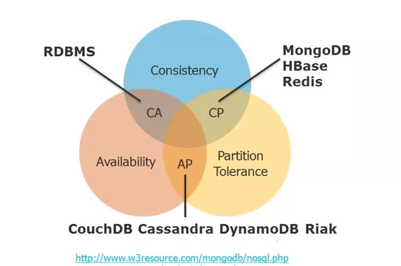
NoSQL Databases with CAP Theorem

Slide 8
Apache Cassandra – An Introduction (Contd.)
It is highly scalable
High performance
Distributed database
Adherence to Availability and Partition Tolerance of CAP Theorem
Consistency using BASE
(Basically Available Soft State Eventual Consistency)

Slide 9
Key Features of Cassandra
Open Source
Distributed
Decentralized (Server Symmetry)
No single point of failure
Column-Oriented Family
Peer to Peer

Slide 10
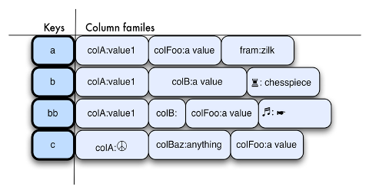
Column-Oriented Family

Slide 11
Peer to Peer Network
A node in Cassandra is structurally identical to any other node.
In case a node fails or is taken offline, it impact throughput
Case of graceful degradation where everything does not come crashing at any given instant.

Slide 12
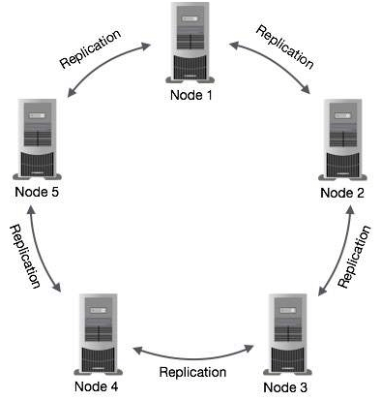
distributed over several machines that operate together.
The outermost container is known as the Cluster.
For failure handling, every node contains a replica, and in case of a failure, the replica takes charge.
It arranges the nodes in a cluster, in a ring format, and assigns data to them.

Slide 13
Gossip Protocol & Failure Detection
Used for intra-ring communication
it is a peer to peer communication protocol
Ease discovery and sharing of location
State information with other nodes in the cluster
Tell me please
I know this
Hey! This is what I know
And This is what I know

Slide 14
Gossip Protocol
In Cassandra, the communication between nodes is often like peer-to-peer communication, where every node talks to the other.
If that’s the case, then all the nodes talk to one another, and there is a lot of communication happening.
The Gossip Protocol is a method to resolve this communication chaos.

Slide 15
Gossip Protocol
In Cassandra, when one node talks to another, the node which is expected to respond, not only provides information about its status, but also provides information about the nodes that it had communicated with before.
Through this process, there is a reduction in network log, more information is kept and efficiency of information gathering increases.
The main feature of the protocol is to provide the latest information of any node respectively.

Slide 16
Failure Detection
An important feature of Gossip Protocol is Failure Detection.
Basically, when two nodes communicate with each other; for instance, Node A to Node B, then Node A sends a message ‘gossipdigestsynmessage’,
which is very similar to TCP protocol to Node B.

Slide 17
Failure Detection
Here, Node B, once receives the message, sends an acknowledgement message ‘ack’, and then Node A responds with an acknowledgement message to Node B’s ‘ack’ message. This is known as the 3 way handshake.
If in case, the node goes down and does not send the ack message, then it will be a mark down.
Even when the nodes are down, the other nodes will be periodically pinging and that is how the failure detection happens.

Slide 18
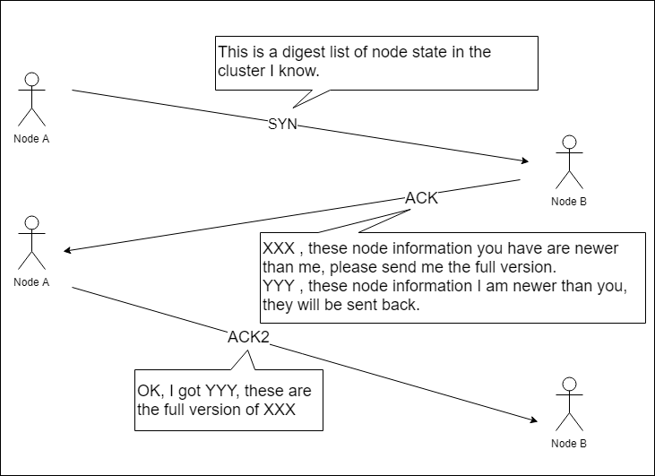

Slide 19
Partitioner
Take care of how to distribute data on the various nodes in a cluster.
It also determine the node on which to place the very first copy of data
Partitioner is hash function
To compute token of the partition key
Helps to identify a row uniquely

Slide 20
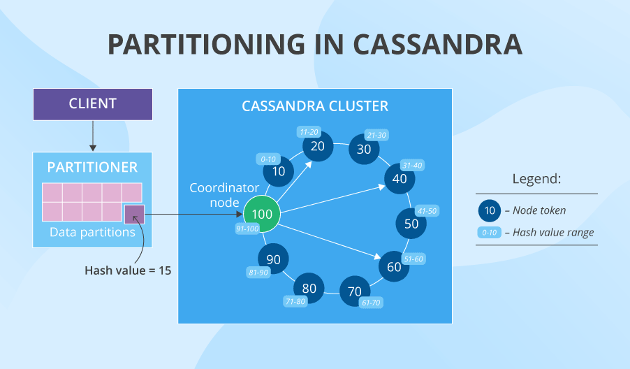

Slide 21
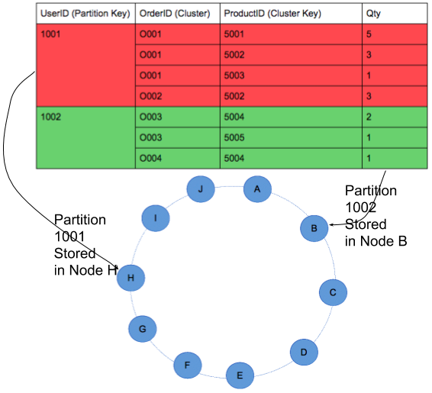

Slide 22
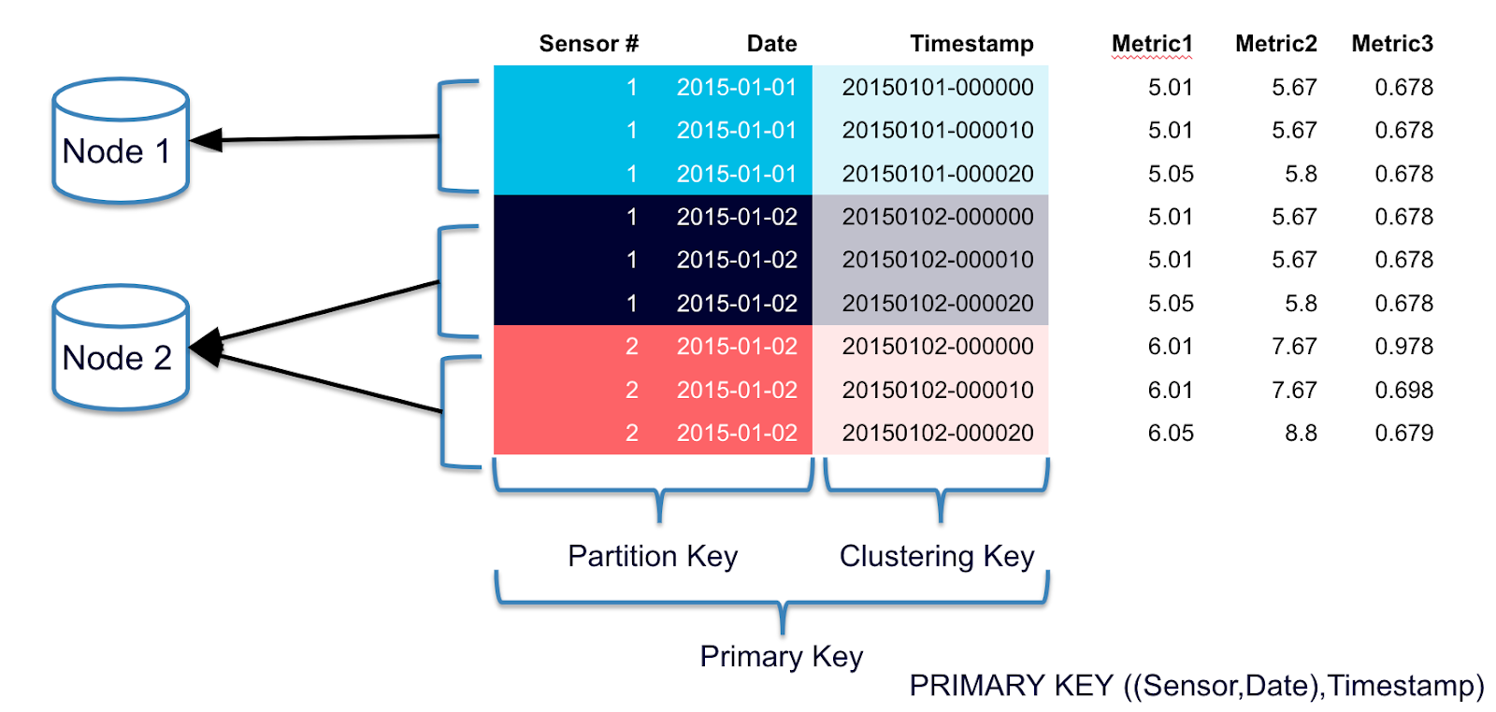
Primary Key

Slide 23
Replication Factor
Cassandra stores replicas on multiple nodes to ensure reliability and fault tolerance.
The total number of replicas across the cluster is referred to as the replication factor.
A replication factor of 1 means that there is only one copy of each row on one node.
A replication factor of 2 means two copies of each row, where each copy is on a different node.
All replicas are equally important; there is no primary or master replica.

Slide 24
Replication Strategies
A replication strategy determines the nodes where replicas are placed.
Two replication strategies are available:
SimpleStrategy: Use for a single data center only. If you ever intend more than one data center, use the NetworkTopologyStrategy.
NetworkTopologyStrategy: Highly recommended for most deployments because it is much easier to expand to multiple data centers when required by future expansion.

Slide 25
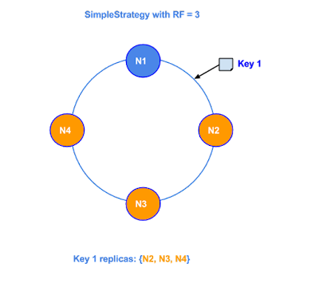
SimpleStrategy
Use only for a single data center.
SimpleStrategy places the first replica on a node determined by the partitioner.
Additional replicas are placed on the next nodes clockwise in the ring without considering topology (rack or data center location).

Slide 26
NetworkTopologyStrategy
Use NetworkTopologyStrategy when you have (or plan to have) your cluster deployed across multiple data centers.
This strategy specify how many replicas you want in each data center.
NetworkTopologyStrategy places replicas in the same data center by walking the ring clockwise until reaching the first node in another rack.

Slide 27
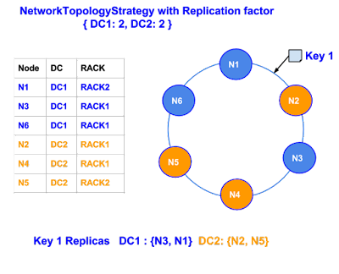
NetworkTopologyStrategy

Slide 28
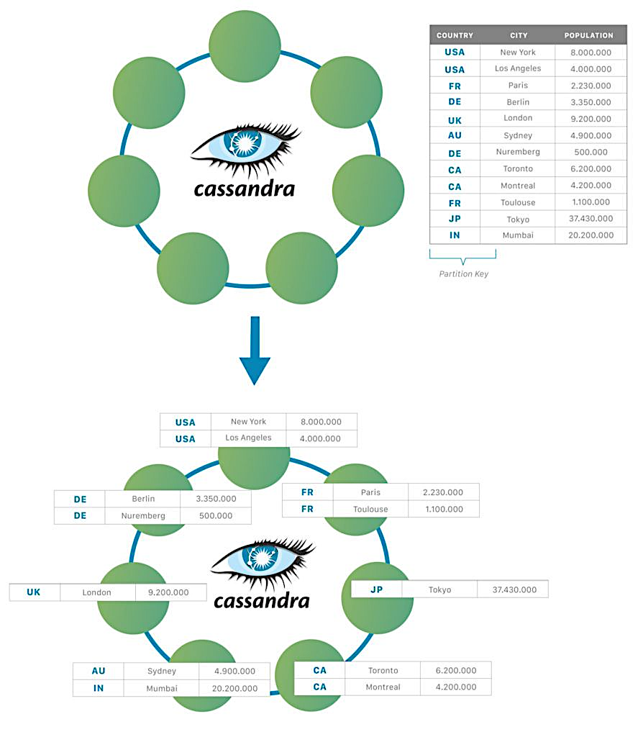

Slide 29
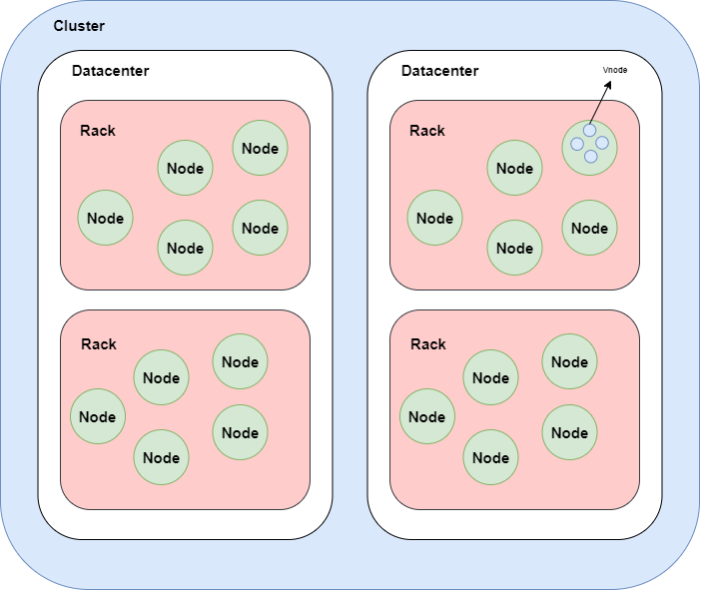
Cluster, Datacenters, Racks and Nodes in Cassandra

Slide 30
Anti Entropy and Read Repair
AntiEntropy means comparing all the replicas of each piece of data that exist (or are supposed to) and updating each replica to the newest version.
Read repair is an important component of keeping data consistent in a Cassandra cluster, because every time a read request occurs, it provides an opportunity for consistency improvement.
As a background process, read repair generally puts little strain on the cluster.

Slide 31
Read Repair
Read repair, as the name suggests, is the process of fixing inconsistencies among the replicas at the time of read.
Example:- Let's say we have three replica at nodes A, B, and C that contain a data X.
During an update, X is updated to X1 in replicas A and B. But it is failed in replica C for some reason.
On a read request for data X, the coordinator node asks for a full read from the nearest node and digest of data X from other nodes to satisfy consistency level.

Slide 32
Example -
The coordinator node compares these values (something like digest(full_X) == digest_from_node_C (Old_X).
If it turns out that the digests are the same as the digests of full read, the system is consistent and the value is returned to the client.
On the other hand, if there is a mismatch, full data is retrieved and reconciliation is done and the client is sent the reconciled value.
After this, in background, all the replicas are updated with the reconciled value to have a consistent view of data on each node.

Slide 33
Components in Cassandra
The key components of Cassandra are as follows −
Node − It is the place where data is stored.
Data Center − It is a collection of related nodes.
Cluster − A cluster is a component that contains one or more data centers.
Commit log − The commit log is a crash-recovery mechanism in Cassandra. Every write operation is written to the commit log.

Slide 34
Components in Cassandra (Cont…)
Mem-table − A mem-table is a memory-resident data structure. After commit log, the data will be written to the mem-table. Sometimes, for a single-column family, there will be multiple mem-tables.
SSTable (Stored String Table)− It is a disk file to which the data is flushed from the mem-table when its contents reach a threshold value.
Bloom filter − These are nothing but quick, and non-deterministic algorithms for testing whether an element is a member of a set. It is a special kind of cache. Bloom filters are accessed after every query.

Slide 35
Writes in Cassandra
A client that initiates a write request.
It is first written to the commit log. A write is taken as successful only if it is written to the commit log.
The next step is to push the write to a memory resident data structure called Mem-table. A threshold value is defined in the Mem-table.
When the number of objects stored in the Mem-table reaches a threshold, the contents of Mem-table are flushed to the disk in a file called SSTable (Stored String Table). Flushing is a non-blocking operation.
It is possible to have multiple Mem-tables for a single column family. One out of them is current and the rest are waiting to be flushed.

Slide 36
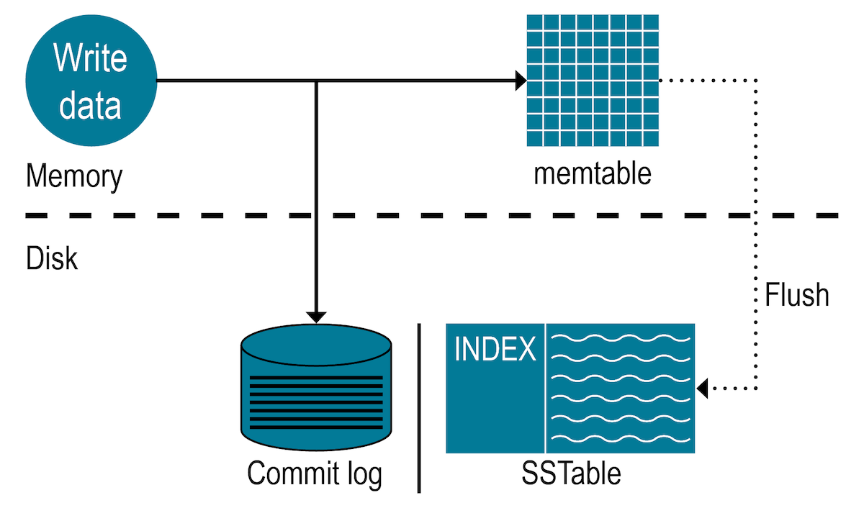

Slide 37
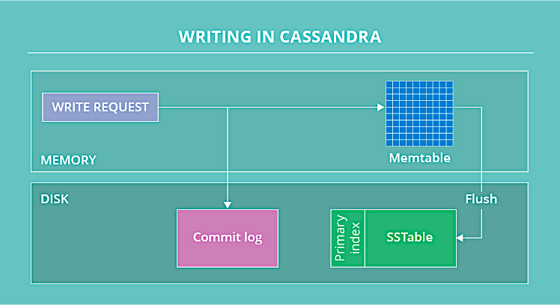

Slide 38
Bloom Filter
A Bloom filter is a generic data structure used to check if an element is present in a set or not. Its algorithm is designed to be extremely fast, at the cost of risking to return false positives.
Cassandra uses bloom filters to test if any of the SSTables is likely to contain the requested partition key or not, without actually having to read their contents (and thus avoiding expensive IO operations).

Slide 39
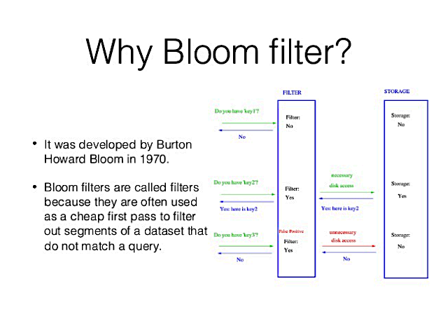

Slide 40
Bloom Filter
If a bloom filter returns false for a given partition key, then it is absolutely certain that the partition key is not present in the corresponding SSTable; if it returns true, however, then the SSTable is likely to contain the partition key.
When this happens, Cassandra will resort to more sophisticated techniques to determine if it needs to read that SSTable or not.
Note that bloom filters are consulted for most reads, and updated only during some writes (when a memtable is flushed to disk).

Slide 41
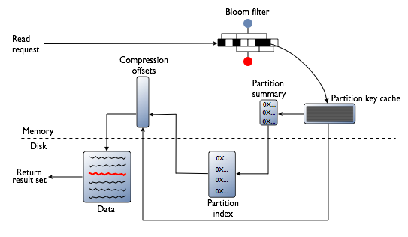
Read Process in Cassandra

Slide 42
Bloom Filter
Bloom filters are maintained per SSTable, i.e. each SSTable on disk gets a corresponding bloom filter in memory.

Slide 43
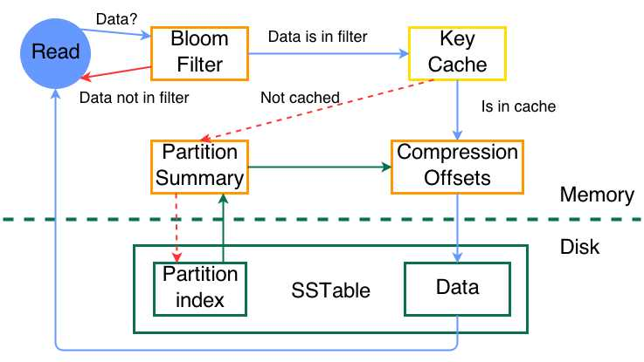

Slide 44
Hinted Handoffs
Replication factor=2

Slide 45
Read Consistency
How many replicas must be respond before sending out the result to client application
ONE | Returns a response from the closest node (replica) holding the data.
QUORUM | Returns a result from a quorum of servers with the most recent timestamp for the data.
LOCAL_QUORUM | Returns a result from a quorum of servers with the most recent timestamp for the data in the same data center as the coordinator node.
EACH_QUORUM | Returns a result from a quorum of servers with the most recent timestamp in all data centers.
ALL | This provides the highest level of consistency of all levels and the lowest level of availability of all levels. It responds to a read request from a client after all the replica nodes have responded.

Slide 46
Examples of Read Consistency Levels
The following read requests using these consistency levels:
QUORUM in a single data center
ONE in a single data center
QUORUM in two data centers
LOCAL_QUORUM in two datacenters
ONE in two data centers
LOCAL_ONE in two data centers

Slide 47
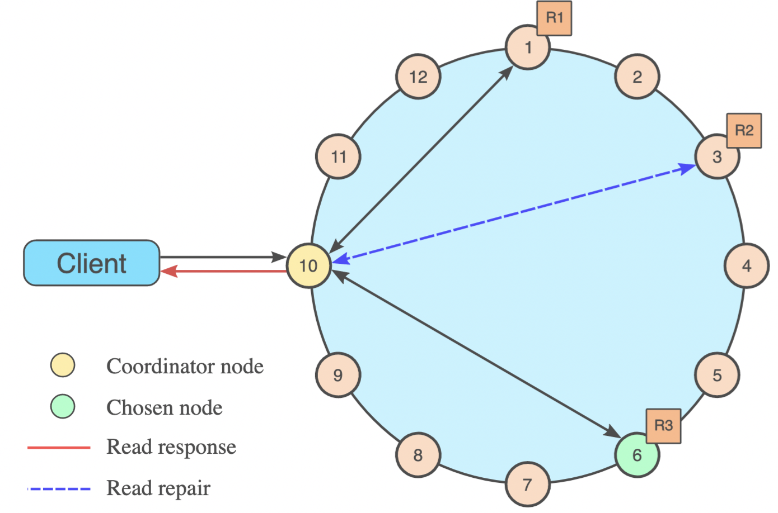
Single DC RF 3 with Read Consistency in QUORUM

Slide 48
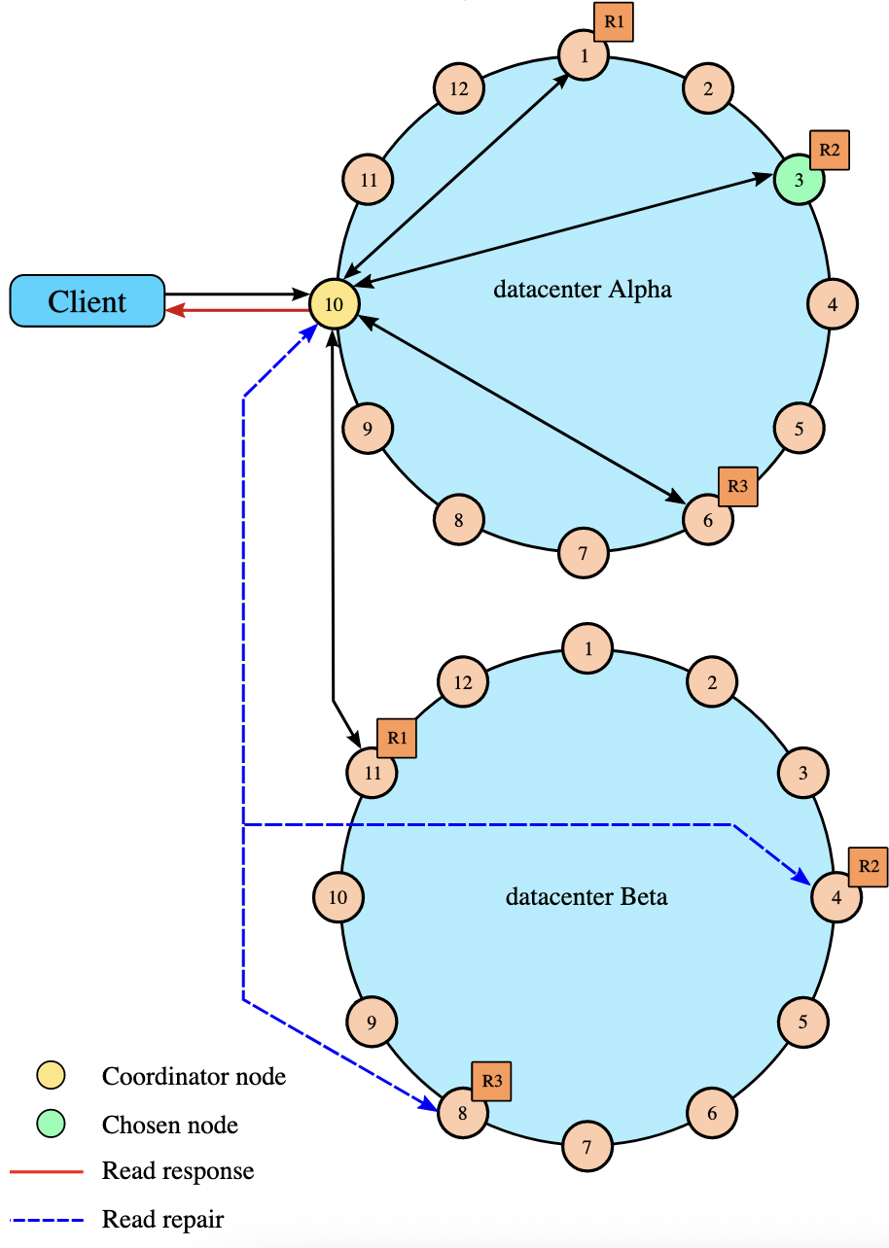
QUORUM in Two Data Centers(DC)

Slide 49
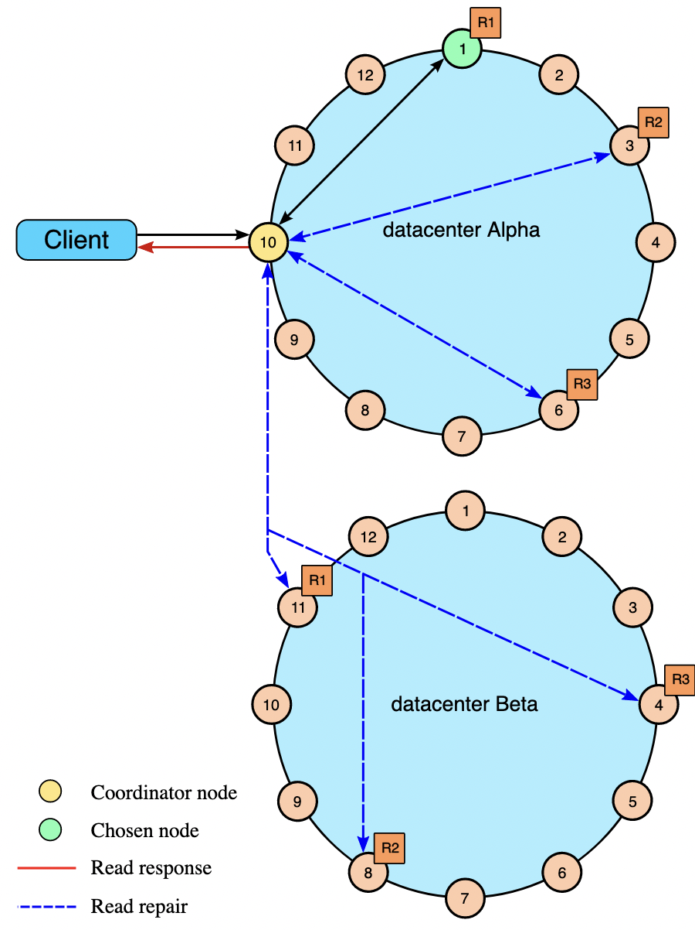
Two DC with Consistency LOCAL_ONE

Slide 50
Write Consistency
How many replicas write must be succeed before sending out an acknowledgement to client application
ALL | This is the highest level of consistency of all levels as it necessitates that a write must be written to the commit log and Memtable on all replica nodes in the cluster.
EACH_QUORUM | A write must be written to the commit log and Memtable on a quorum of replica nodes in all data centers.
QUORUM | A write must be written to the commit log and Memtable on a quorum of replica nodes.
LOCAL_QUORUM | A write must be written to the commit log and Memtable on a quorum of replica nodes in the same data center as the coordinator node. This is to avoid latency of inter-data center communication.
ONE | A write must be written to the commit log and Memtable of at least one replica node.
TWO | A write must be written to the commit log and Memtable of at least two replica nodes.
THREE | A write must be written to the commit log and Memtable of at least three replica nodes.
LOCAL_ONE | A write must be sent to, and successfully acknowledged by, at least one replica node in the local data center.

Slide 51
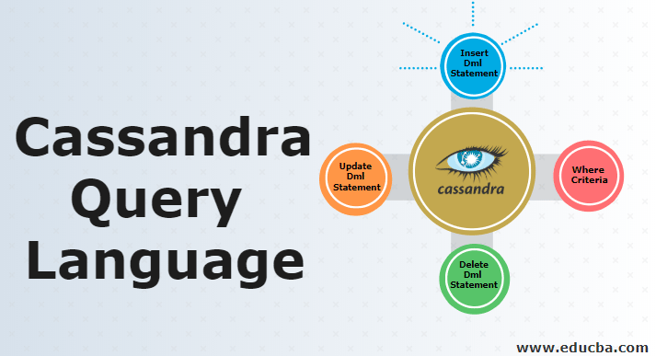

Slide 52
Cassandra Query Language (CQL)
CQL offers a model similar to SQL. The data is stored in tables containing rows of columns.
Visit at (https:/cassandra.apache.org/doc/latest/cassandra/cql/)

Slide 53
CQL Data Types
Int | 32 bit signed integer
Bigint | 64 bit signed long
Double | 64-bit IEEE-754 floating point
Float | 32-bit IEEE-754 floating point
Boolean | True or false
Blob | Arbitrary bytes, expressed in hexadecimal
Counter | Distributed counter value
Decimal | Variable – precision integer
List | A collection of one or more ordered elements
Map | A JSON style array of elements
Set | A collection of one or more elements
Timestamp | Date plus time
Varchar | UTF 8 encoded string
Varint | Arbitrary-precision integers
Text | UTF 8 encoded string

Slide 54
CQLSH
A prompt to work with CQL or separate application language drivers.
Users can access Cassandra through its nodes using Cassandra Query Language (CQL). CQL treats the database (Keyspace) as a container of tables.
Keyspace: Defines how a dataset is replicated, per datacenter. Replication is the number of copies saved per cluster. Keyspaces contain tables.

Slide 55
CQLSH
Table: Defines the typed schema for a collection of partitions. Tables contain partitions, which contain rows, which contain columns. Cassandra tables can flexibly add new columns to tables with zero downtime.
Partition: Defines the mandatory part of the primary key. All rows in Cassandra must have to identify the node in a cluster where the row is stored.
Row: Contains a collection of columns identified by a unique primary key (partition key + clustering keys.)

Slide 56
Shell Commands (cqlsh)
HELP - Displays help topics for all cqlsh commands.
CAPTURE - Captures the output of a command and adds it to a file.
CONSISTENCY - Shows the current consistency level, or sets a new consistency level.
COPY - Copies data to and from Cassandra.
DESCRIBE - Describes the current cluster of Cassandra and its objects.
EXPAND - Expands the output of a query vertically.

Slide 57
cqlsh cont…
EXIT - Using this command, you can terminate cqlsh.
PAGING - Enables or disables query paging.
SHOW - Displays the details of current cqlsh session such as Cassandra version, host, or data type assumptions.
SOURCE - Executes a file that contains CQL statements.
TRACING - Enables or disables request tracing.

Slide 58
CQL Data Definition Commands
CREATE KEYSPACE - Creates a KeySpace in Cassandra.
USE - Connects to a created KeySpace.
ALTER KEYSPACE - Changes the properties of a KeySpace.
DROP KEYSPACE - Removes a KeySpace
CREATE TABLE - Creates a table in a KeySpace.
ALTER TABLE - Modifies the column properties of a table.

Slide 59
CQL Data Definition Cmd (cont…)
DROP TABLE - Removes a table.
TRUNCATE - Removes all the data from a table.
CREATE INDEX - Defines a new index on a single column of a table.
DROP INDEX - Deletes a named index.

Slide 60
CQL Data Manipulation Cmd
INSERT - Adds columns for a row in a table.
UPDATE - Updates a column of a row.
DELETE - Deletes data from a table.
BATCH - Executes multiple DML statements at once.

Slide 61
CQL Clauses
SELECT - This clause reads data from a table
WHERE - The where clause is used along with select to read a specific data.
ORDERBY - The orderby clause is used along with select to read a specific data in a specific order.

Slide 62
CRUD - Keyspace
To create a keyspace by the name “Students”
To describe all the existing keyspaces
CREATE KEYSPACE Students WITH REPLICATION = {
'class': 'SimpleStrategy',
'replication_factor': 1
};
DESCRIBE KEYSPACES;

Slide 63
CRUD – Create Table
To create a column family or table by the name “student_info”.
CREATE TABLE Student_Info (
RollNo int PRIMARY KEY,
StudName text,
DateofJoining timestamp,
LastExamPercent double
);

Slide 64
Primary key
List of columns
First item in PRIMARY KEY is the partition key
Primary can be simple or composite
create table users (
username varchar,
firstname varchar,
lastname varchar,
email list <varchar>,
password varchar,
created_date timestamp,
PRIMARY KEY (username)
);

Slide 65
Primary key
But the primary key can also be COMPOSITE (or COMPOUND), generated from more columns.
In a situation of COMPOSITE primary key, the "first part" of the key is called PARTITION KEY (in this example key_part_one is the partition key)
the second part of the key is the CLUSTERING KEY (key_part_two)
CREATE TABLE stackoverflow (
key_part_one text,
key_part_two int,
data text,
PRIMARY KEY(key_part_one, key_part_two)
);

Slide 66
Partition Key and Clustering Key
Please note that the both partition and clustering key can be made by more columns
create table stackoverflow (
k_part_one text,
k_part_two int,
k_clust_one text,
k_clust_two int,
k_clust_three uuid,
data text,
PRIMARY KEY((k_part_one,k_part_two), k_clust_one, k_clust_two, k_clust_three) );

Slide 67
Partition and Clustering Key
The Partition Key is responsible for data distribution across your nodes.
The Clustering Key is responsible for data sorting within the partition.
The Primary Key is equivalent to the Partition Key in a single-field-key table.
The Composite/Compound Key is just a multiple-columns key

Slide 68
Composite Key
A primary key uniquely identifies a row.
A composite key is a key formed from multiple columns.
A partition key is the primary lookup to find a set of rows, i.e. a partition.
A clustering key controls how the rows are ordered in a partition (in addition to writetime).

Slide 69
Examples
PRIMARY KEY (a): The partition key is a.
PRIMARY KEY (a, b): The partition key is a, the clustering key is b.
PRIMARY KEY ((a, b)): The composite partition key is (a, b).
PRIMARY KEY (a, b, c): The partition key is a, the composite clustering key is (b, c).
PRIMARY KEY ((a, b), c): The composite partition key is (a, b), the clustering key is c.
PRIMARY KEY ((a, b), c, d): The composite partition key is (a, b), the composite clustering key is (c, d).

Slide 70
Describe tables
To list all tables in current keyspace or in all keyscapes if there is no current keyspace.
DESCRIBE TABLES;

Slide 71
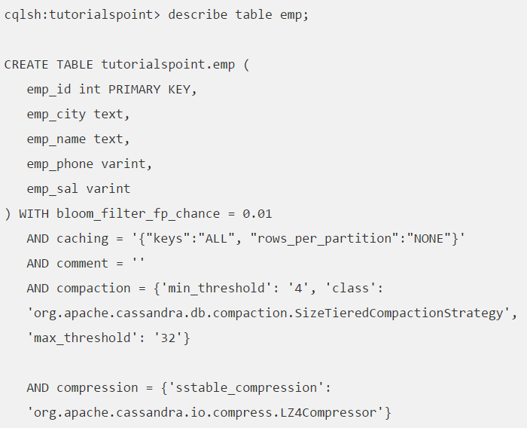
Describe table
This command provides the description of a table. Given below is the usage of this command.

Slide 72
CRUD - Insert
To insert data into the column family “student_info”.
BEGIN BATCH
INSERT INTO student_info (RollNo,StudName,DateofJoining,LastExamPercent)
VALUES (1,'Michael Storm','2012-03-29', 69.6)
INSERT INTO student_info (RollNo,StudName,DateofJoining,LastExamPercent)
VALUES (2,'Stephen Fox','2013-02-27', 72.5)
APPLY BATCH;

Slide 73
Insert always overwrite
Insert into users (username, firstname, lastname, email, password, created_date)
values ('pmcfadin', 'Patrick', 'McFadin', ['patrick@datastax.com'], 'passuser23', '2017-03-24 11:36:00');

Slide 74
CRUD - Select
To view the data from the table “student_info”.
SELECT *
FROM student_info;
SELECT *
FROM student_info
where RollNo IN (1,2,3);

Slide 75
CRUD – Create Index
To create an index on the “studname” column of the “student_info” column family use the following statement
CREATE INDEX ON student_info(studname);
SELECT *
FROM student_info
where studname=‘Rajeev’;
Now this stmt will successfully run

Slide 76
Suppose we have index
CREATE INDEX ON student_info(lastexampercent);
Then
SELECT *
FROM student_info
where lastexampercent>36.9;
This will generate an error as index allow only = operator
To run this add ALLOW FILTERING as

Slide 77
SELECT *
FROM student_info
where lastexampercent>36.9 ALLOW FILTERING;
Allow filtering will filter result with greater than , less than and others
No need to create index

Slide 78
To restrict number of rows in Output
SELECT *
FROM student_info LIMIT 2;

Slide 79
CRUD – Update
To update the value held in the “StudName” column of the “student_info” column family to “Mahesh Kumar” for the record where the RollNo column has value = 2.
Note: An update modify one or more column values for a given row to the Cassandra table. It does not return anything.
UPDATE student_info SET StudName = ‘Mahesh Kumar' WHERE RollNo = 2;

Slide 80
CRUD – Update
Primary key column cannot be update
UPDATE student_info SET RollNo = 9 WHERE RollNo = 2;
it does not allow update to a primary key column

Slide 81
CRUD – Delete
To delete the column “LastExamPercent” from the “student_info” table for the record where the RollNo = 2.
Note: Delete statement removes one or more columns from one or more rows of a Cassandra table or removes entire rows if no columns are specified.
DELETE LastExamPercent FROM student_info WHERE RollNo=2;
RollNo | Stud_name | LastExamPercent
2 | Mahesh Kumar | null

Slide 82
CRUD – Delete
DELETE FROM student_info WHERE RollNo=2;
This will delete a complete row from table

Slide 83
Order By - Clause
SELECT * FROM Project where pID IN (1,2,3)
order by pname DESC;
Table PROJECT has composite primary key pID, pName
Asc for ascending
“Order by” apply on single column
the ORDER BY clause defines the clustering column to use for ordering.

Slide 84
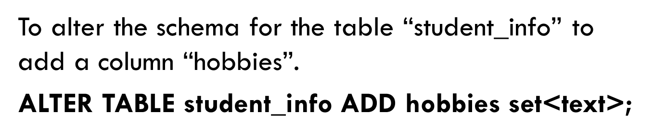
Set Collections
Set -A Set stores group of elements that returns sorted elements when querying.

Slide 85
Collections - Set

Slide 86
Collections - Set

Slide 90
Collections - Map
Map Collections :The map is a collection type that is used to store key value pairs. As its name implies that it maps one thing to another.
To alter the “users” table to add a map column “todo”.
ALTER TABLE users
ADD todo map<timestamp, text>;

Slide 91
Time To Live
Data in a column, other than a counter column, can have an optional expiration period called TTL (time to live). The client request may specify a TTL value for the data. The TTL is specified in seconds.
CREATE TABLE userlogin(
userid int primary key, password text
);
INSERT INTO userlogin (userid, password) VALUES (1,'infy') USING TTL 30;
SELECT TTL (password)
FROM userlogin
WHERE userid=1;

Slide 92
Time To Live

Slide 101
TRACING
Enables and disables tracing for transactions on all nodes in the cluster.
Use tracing to troubleshoot performance problems.
Detailed transaction information related Cassandra internal operations is captured in the system_traces keyspace.
When a query runs a session id displays in the query results and an entry with the high-level details such as session id and client, and session length, is written to the system_traces.session table.
More detailed data for each operation Cassandra performed is written to the system_traces.events table.
Tracing information is saved for 24 hours.
To save tracing data longer than 24 hours, copy it to another location.
Note:
The session id is used by the
SHOW SESSION tracing_session_id
command to display detailed event information.
TRACING [ON | OFF]

Slide 102
Tracing a write request
Turn on tracing:
TRACING ON
Insert a record into the cyclist_name table:
INSERT INTO cycling.cyclist_name (
id,
lastname,
firstname
)
VALUES (
e7ae5cf3-d358-4d99-b900-85902fda9bb0,
'FRAME',
'Alex' );

Slide 103
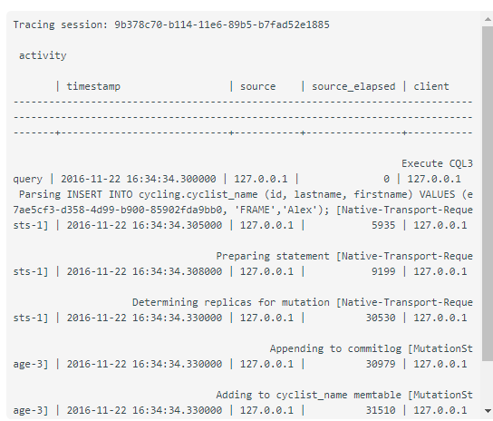
Tracing a write request
The request and each step are captured and displayed.
Tracing session: 9b378c70-b114-11e6-89b5-b7fad52e1885

Slide 104
Tracing a sequential scan
A single row is spread across multiple SSTables. Reading one row involves reading pieces from multiple SSTables, as shown by this trace of a request to read the cyclist_name table.
SELECT * FROM cycling.cyclist_name ;
The query results display first, followed by the session ID and session details

Slide 105
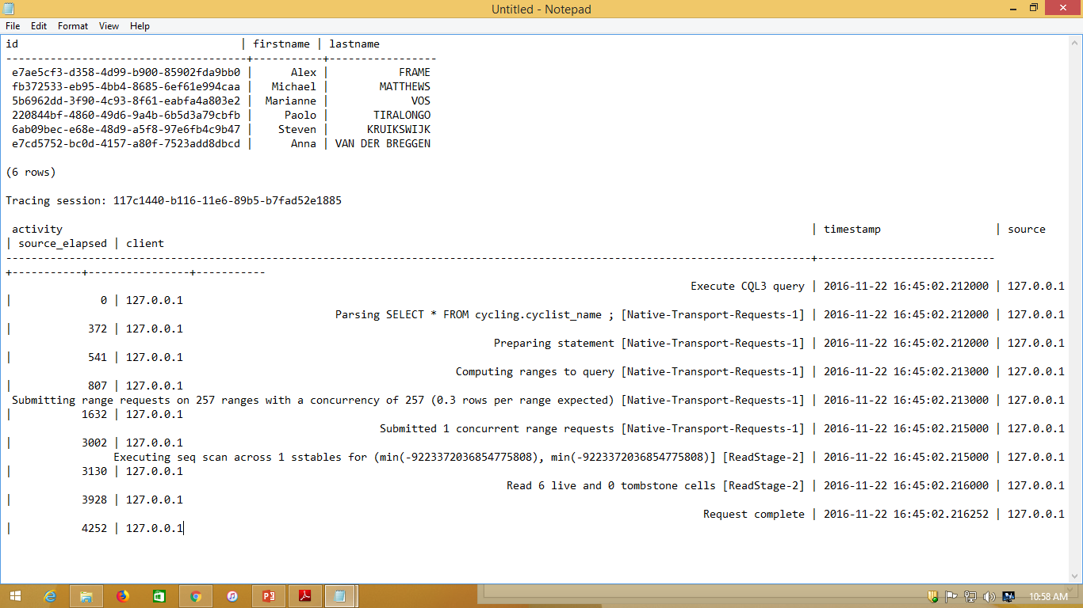

Slide 106
Export data to a CSV file
Export the contents of the table/column family “elearninglists” present in the “students” database to a CSV file (d:\elearninglists.csv).
COPY elearninglists (id, course_order, course_id, courseowner, title) TO 'd:\elearninglists.csv';

Slide 107
Import data from a CSV file
To import data from “D:\elearninglists.csv” into the table “elearninglists” present in the “students” database.
COPY elearninglists (id, course_order, course_id, courseowner, title) FROM 'd:\elearninglists.csv';

